Slide 1




Weekly Meeting
Liri Chen, Shuo Lin, Wenqi Sun, Zhexin Wang, Zixiao Zhang

Slide 2
Aligned Timeline
Time | Milestone | Status
Oct 3 - Oct 17 | Baseline, metrics | Done
Oct 18 - Oct 31 | Data Retrieval Optimization UI Design | Done
Nov 1 - Nov 21 | Prototype & demo(Search w/o GPT + WebApp) Data Retrieval Integration & Optimization | In Progress Backend is ready, webpage connection nearly done Keyword-based search done (need some optimization)
Nov 22 - Nov 28 | Backend API & UI design
Nov 29 - Dec 16 | Final Presentation

Slide 3
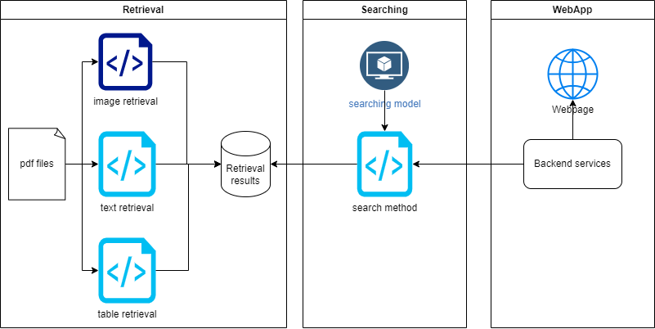
Architecture

Slide 4
Current design for second part
Stage 1
Users’ input: (year, company, keywords)
We match keywords with the text/table on each page using LLM
Return the content on the most relevant page (png)
We encountered a slight issue with the setup(installing `poppler`).
Stage 2
Users’ input: (year, company, any sentences or words)
We first find out the most relevant page(same as stage 1)
Then we try to return a portion of the page that is accurately related to the input (in zip files/basic database)

Slide 5
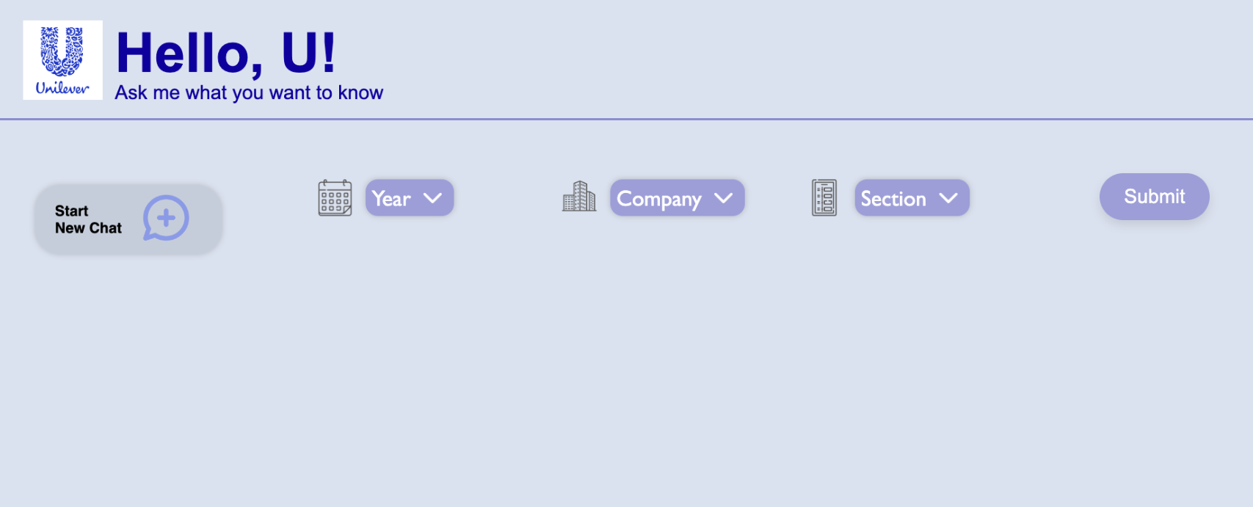
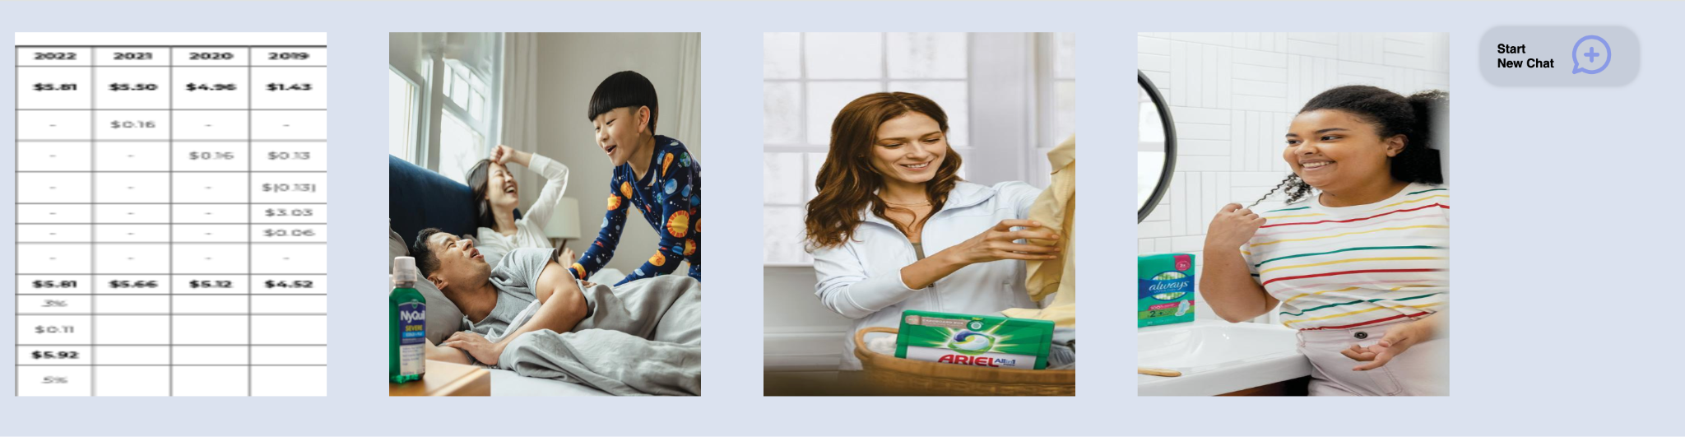
Web App
Current functionality:
Select Year, Company, and Section for data retrieval
Back-end locates files based on the keyword
Option to start new chat for queries
Chat history

